Slide 1

Telecom Customer Churn Analysis
NAME : Yuvaraju
BATCH NO : 403
BRANCH : Innomatics Research Labs,

Slide 2


Slide 3
CUSTOMER CHURN ANALYSIS :
Telecom Customer Churn Analysis is the process of finding out why customers are leaving a telecom company (disconnecting services) and which customers are likely to leave in the future.
Churn --- > customers stopping their service..
Churn analysis ----> studying customer behaviour to understand and reduce churn
Purpose of Churn Analysis
Reduce customer loss
Identify high-risk customers
Improve customer experience
Increase company revenue
Make better business decisions

Slide 4

AGENDA :
Introduction
Project Overview
Data Source
Data Preparation
Dashboard Visualizations
Problem Statement
Applications & Recommendations
Conclusion

Slide 5
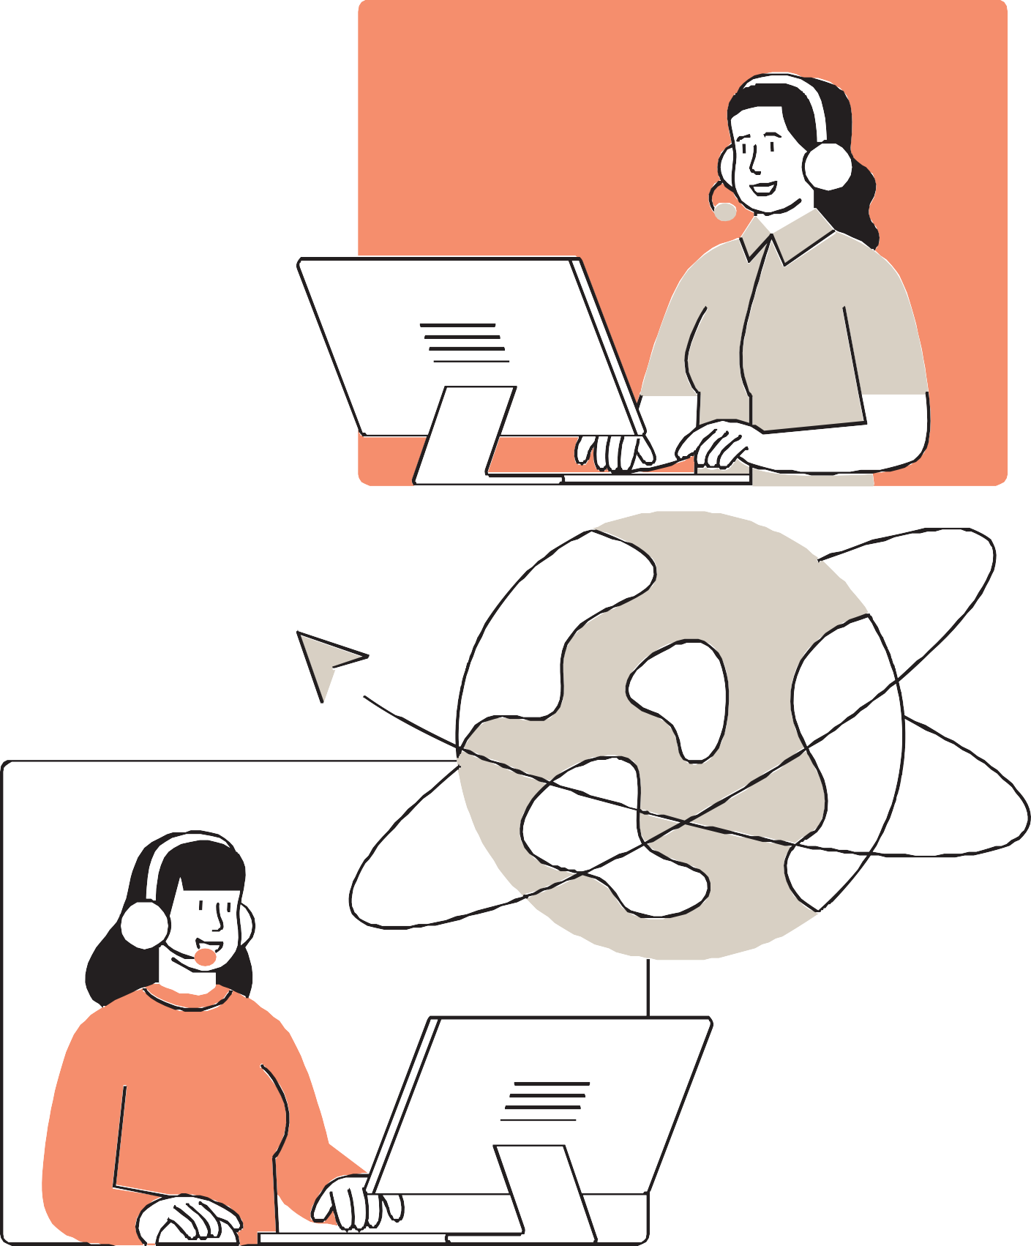
OBJECTIVE :
To find out why customers are leaving the company.
To understand which customers are more likely to churn.
To help the business reduce customer churn using data insights.
PROBLEM STATEMENT :
"Many customers are leaving the telecom service. The company does not know the exact reasons for this churn. We need to analyze the data to identify the main factors that cause customers to leave and help the company retain them."

Slide 6

DATA PREPARATION :
Load the data from Data Set in CSV file.
Open Transform Data and change all columns to the correct data type.
Use Trim and Clean to remove spaces and unwanted characters.
Remove duplicates and blank rows.
Use Replace Values to fix spelling errors or incorrect category names.
Fill or replace null values with 0 or “Unknown”.
Delete unwanted columns and click Close & Apply to load the cleaned data.

Slide 7

Dashboard Visualizations :
1. Customer Demographics Dashboard
Visuals Used:
Donut Chart → Gender distribution
Bar Chart →Senior citizen vs. non-senior churn comparison
Column Chart → Tenure segmentation
Line Chart → Churn rate across tenure groups
Cards → Total Customers, Churned Customers,
Churn Rate, Avg. Tenure, Avg. Monthly Charges
Purpose: Understand customer profile and churn
behavior by demographics.

Slide 8

DASHBOARD VISUALIZATIONS :
2. Service Subscription Dashboard
Visuals Used:
Stacked Column Chart → Phone service and internet service usage
Funnel Chart → Churn rate by Internet Service Type (DSL, Fiber Optic, No Internet)
Clustered Bar Chart → Add-on service usage by churned customers
Scatter Plot → Correlation between number of services and churn
Pie Chart → Fiber vs. DSL vs. No Internet customers
Slicers → Gender, Senior Citizen, Internet Service, Contract Type
Purpose: Identify which services and combinations impact churn the most.

Slide 9
Dashboard Visualizations
3. Contract & Billing Dashboard
Visuals Used:
Bar Chart → Churn by Contract Type (Month-to-month, One year, Two year)
Donut Chart → Payment Method distribution
Clustered Column Chart → Avg. Total Charges by Contract
Type Line Chart → Monthly Charges by Payment Method
Matrix/Table → Billing KPIs by Contract Type
Cards → Avg. Monthly Charge, Avg. Total Charge, Churn Rate, Total Churned Customers
Purpose: Analyze billing behavior and contractual patterns influencing churn.

Slide 10
PROJECT OVERVIEW :
To analyze customer churn patterns and identify the key factors influencing customer attrition.
understand customer behavior based on demographics, service subscriptions, and billing information.
To measure churn rate across various customer segments such as contract type, internet service, and payment method.
To visualize business performance using interactive Power BI dashboards and KPIs.
To predict churn risk and highlight high-risk customer segments for targeted retention strategies.
To support data-driven decisions that can reduce churn, increase customer satisfaction,
and improve revenue stability.

Slide 11
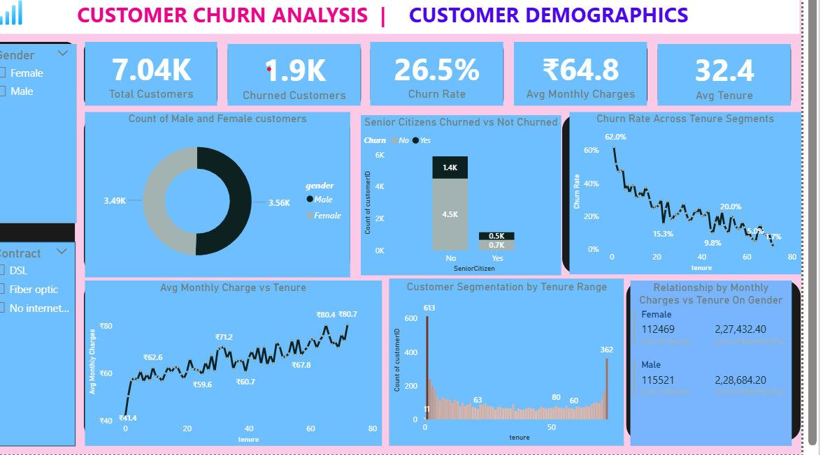
t

Slide 12
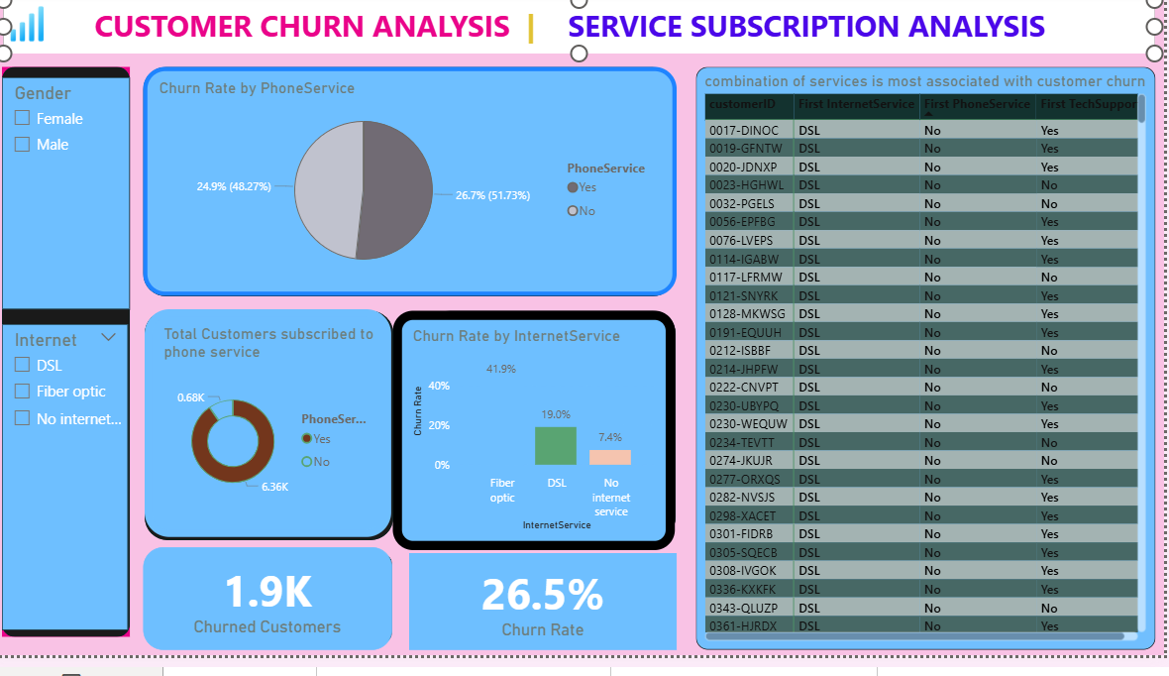

Slide 13
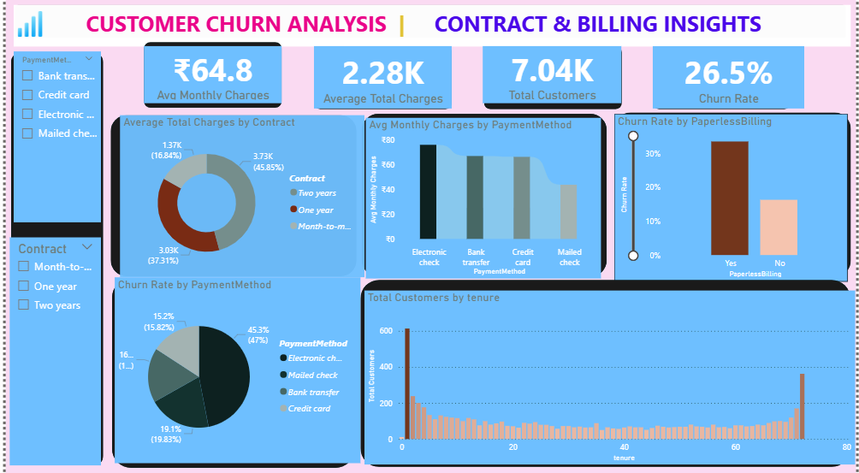

Slide 14
Applications & Recommendations :
Applications :
Used by Marketing Teams to identify and target high-risk customers with retention offers.
Helps Customer Support prioritize service improvement for segments with high churn.
Enables Management to track key churn KPIs and make data-driven strategic decisions.
Supports Product Teams in optimizing service bundles and pricing models.
Recommendations :
Encourage long-term contracts (1-year or 2-year plans) through discounts and loyalty rewards.
Promote bundled service packages (e.g., Internet + Streaming + Security) to reduce churn.
Improve customer retention by offering personalized plans for senior citizens and high-charge users.
Educate customers about benefits of online backup and device protection services, as these reduce
churn. Monitor monthly charges and payment issues closely for early churn indicators.

Slide 15
CONCLUSION :
The Power BI dashboards provided clear visibility into customer churn behavior and patterns.
Analysis revealed that high monthly charges, month-to-month contracts, and fiber optic services are major churn drivers.
Customers with longer tenure and multiple service subscriptions show greater loyalty and lower churn.
Demographic factors such as senior citizen status and partner/dependent presence also influence
churn tendency.
The insights enable the company to design targeted retention strategies and reduce customer loss.
Implementing data-driven actions can help boost customer satisfaction, increase retention rate, and maximize revenue.
Overall, the project demonstrates how Power BI transforms raw data into actionable business
insights for strategic decision-making.

Slide 16


